Slide 1

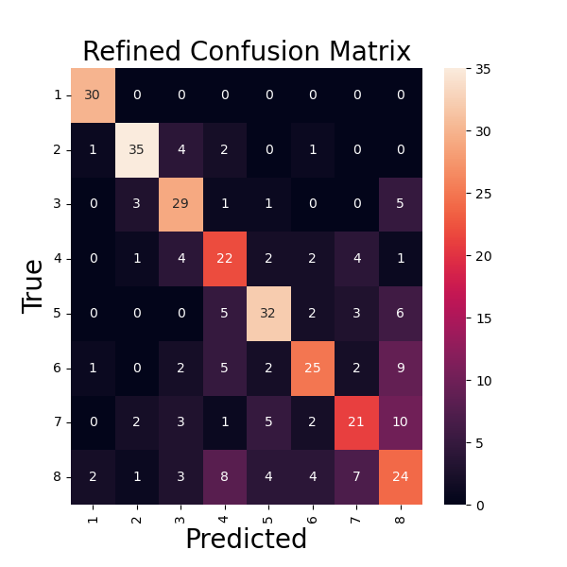
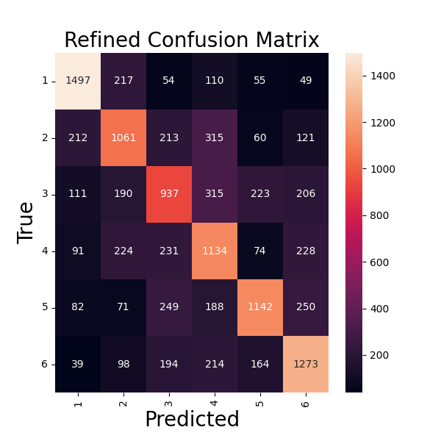
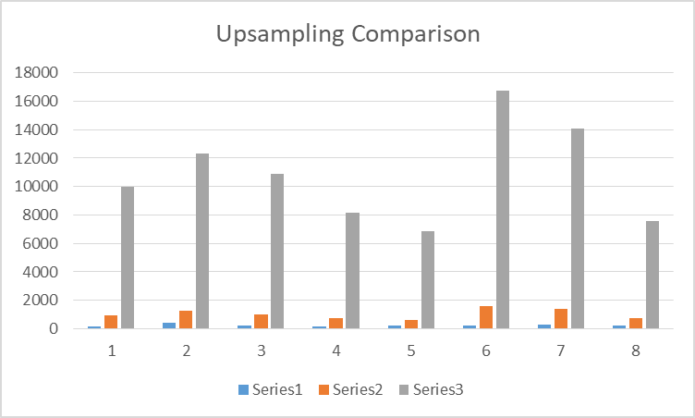
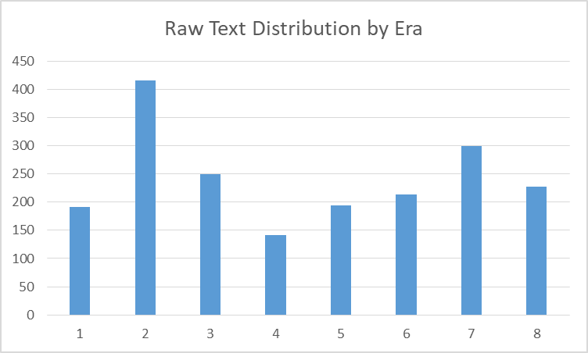
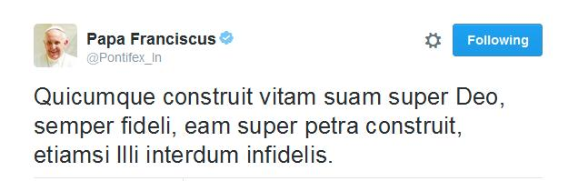

DLT2: Dating Latin Texts with Deep Learning Techniques
Mitchell Allen,
Paul Hoffmann
Linguistic Background
Approach
Latin is a classical language that was spoken in Rome. Due to the Roman Empire’s expansion, it spread throughout Europe, as well as parts of Asia and Africa. The language was widely employed as the top choice for international communication until the mid-18th century when it was gradually supplanted by English, French, and others. It is still used today by the Catholic Church. Historically, the date when many texts were written is uncertain or completely unknown.
Data
Model trains on a corpus of 2,220 texts
Downsampling results in 141 texts in each of 8 eras
Upsampling is performed through dividing each text into 10,000 character and 1,000 character “subtexts”
10k split totals 8,366 subtexts
1k split totals 86,577 subtexts
Confusion matrix from merging eras 2 and 3 and removing Modern Latin
Best Test Results
Accuracy | 61%
F1 Score | 61%
Precision | 63%
Recall | 60%
Related Work
A tested approach in a novel context
As far as we are aware, deep learning has not been used to date Latin texts, although there have been several projects attempting to date texts in other languages, including Chinese, Sanskrit, and Old English. The most prominent of these may be Deep Mind’s “Ithaca” for Ancient Greek:
Can date texts within 30 years on average
For inscriptions, provides an estimated geolocation
Also restores missing/damaged texts
Bidirectional LSTM Model Details
Batch size is 32
Trains for 5-20 epochs
Show model diagram?
Conclusion
Overall, the model achieved an impressive level of success for this initial foray into applying deep learning to Latin text date approximation. In the future, we would like to create subtext datasets with even smaller windows (500 characters) and ask the model to classify texts into narrower time windows. It would also be useful to test the extensibility of this approach to other less-studied classical languages.
Revised Era Distributions
Eras 2 and 3 combined due to covering the shortest time period and being the most commonly confused
Modern Latin texts removed due to emulation of earlier styles

